Slide 1

Making this resource work for you
Prior to teaching this lesson, please refer to the ‘Unit Overview and Planning Document’.
Further guidance on planning Science Mastery lessons can be found in the detailed planning guidance document.
Refer to the ‘notes’ section on each slide for useful information, including suggested expositions, pedagogical content knowledge, suggested questions, answers and more. Consider using presenter mode so you can see this guidance throughout the lesson.
The introduction slides can be adapted to suit your teaching style and the needs of your class.
Before the lesson, adapt the fix-it slide to address any misconceptions identified in the previous lesson’s exit ticket.
Choose from the suggested activities to suit your class. The intention is not that you complete all of these, but that you select those which ones are most appropriate for your students. It may be appropriate to further adapt activities for your students.
These lessons are designed to occupy approximately 1 hour. To adapt for a shorter or longer lesson duration we advise you to adapt the activity section accordingly.
Please consider using the final slide to send feedback about this lesson or examples of PowerPoints that you have adapted to our design team. Your feedback is used to improve Science Mastery for all of our teachers and students. We appreciate all suggestions and comments.
Thank you for reading!
The Science Mastery Team

Slide 2
Prior Knowledge Review
Answer these questions using the food chain:
State the producer in this food chain.
State which species is the secondary consumer.
State which species is a predator and which is prey.
State the process by which producers make their own food.
How are herbivores and carnivores different?
Fox
Grass
Rabbit
Fox
The fox is a predator and the rabbit is prey.
Grass
Photosynthesis
Herbivores only eat plants whereas carnivores only eat meat/other animals
Notes:
Purpose: to assess learning at the beginning of the new unit and interleave key prior knowledge from B1.3.
Foundation question: Explain the differences between a producer and a consumer
Answer: A producer produces its own food a consumer consumes/eats its food
Stretch question: Describe what would happen if the rabbits all died because of a disease.
Answer: The foxes would die out because they would have nothing to eat and the grass would be able to grow more because it would not be eaten.

Slide 3
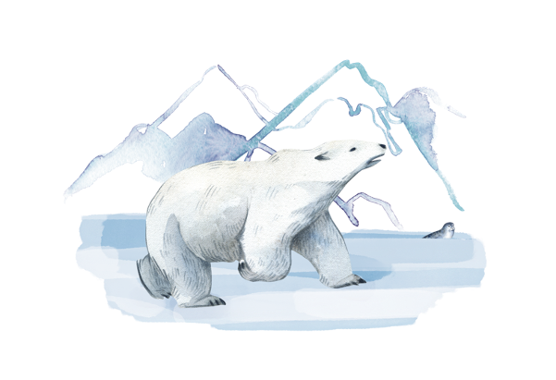

B3.2.1
25/05/2022
Prior Knowledge Review
B3.2.1 Prior Knowledge Review
B3.2.2 Biodiversity
B3.2.3 How Humans Affect Biodiversity
B3.2.4 How Humans can Preserve Biodiversity
B3.2.5 The Effect of Pollution on Biodiversity
B3.2.6 Global Warming
B3.2.7 Taking It Further: Pyramids of Biomass
B3.2.8 Taking It Further: Farming and Biotechnology
B3.2.9 Taking It Further: Food Security
Notes:
Big Idea: Organisms are interdependent
Prior knowledge: Prior to this unit pupils will have studied the Y7 unit B1.3 Interdependence. Pupils will have studied ecosystems, feeding relationships, competition in animals and plants, and abiotic and biotic factors that affect communities of organisms. Pupils will have also learn about sampling techniques that are used to measure the distribution of species in an area. Pupils will have an understanding of the different trophic levels in food chains from unit B1.3 Interdependence and this knowledge will be applied and deepened in this unit where pyramids of biomass will be constructed and analysed.
Hook:
In year 7 we learnt about food webs and how individuals in communities interact with each other and the environment around them however we looked more at organisms in the wild rather than in areas also populated with humans. This unit we are going to learn about the issues that can be caused when humans interact with the environment around them, how sometimes this can benefit humans but be detrimental to different ecosystems. Finally we look at what changes humans could make to counteract better protect wildlife going forward.

Slide 4

Following this lesson, students will be able to:
State the definitions of producer, consumer, predator and prey
Describe the transfer of energy through a food chain
Explain the importance of plants in food chains
Key Words:
producer
consumer
species
ecosystem
habitat
photosynthesis
Notes:
Can be edited depending on class need.

Slide 5
This is the fix-it portion of the lesson
The fix-it is an opportunity to respond to gaps in knowledge, especially those identified by the previous lesson’s exit ticket.
The teacher should customise this slide as needed, to facilitate
reteach, explanation, demonstration or modelling of ideas and concepts that students have not yet grasped or have misunderstood.
practice answering specific questions or of key skills.
redrafting or improving previous work.
Notes:
Purpose: to spend time on any gaps identified in previous learning from pre-unit quiz.

Slide 6
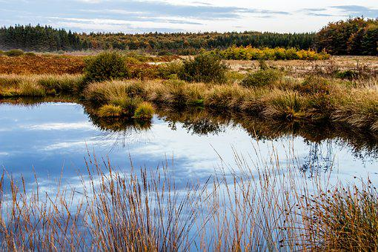
Interdependence
Organisms are interdependent
Feeding relationships can be shown using food chains or food webs
A population is a group of organisms of the same species
A community is two or more populations of organisms (different species)
A habitat is the place where an organism lives
An ecosystem is the interaction between the community and the non-living parts of their environment (their habitat)
Notes:
Purpose: to spend time on any gaps in knowledge from B1.3.
Suggested guidance:
Big idea of this unit is that organisms are interdependent – so it may be worth revisiting the definition of this term, and looking at the etymology to help pupils understand the definition. Inter meaning between or among, and dependent meaning relying on something (e.g. children are dependents).
These terms should all be familiar to pupils, either from primary science or from B1.3. Pupils will get further practice of these definitions during the rest of the lesson.
These are suggested terms to recap, as pupils struggle more with these as they are generally less familiar than terms such as predator, prey, consumer, producer, herbivore, carnivore and omnivore etc.
Pupils may need a reminder on the definition of species:
A species is a group of organisms that can breed to produce (fertile) offspring
It can be useful to use the above image to get pupils to suggest examples of these terms.
Population – any group of one species, specific tree types, grass types or animals/insects (not shown in this picture but might be useful to show).
Community – multiple species, e.g. community of all the tree species
Habitat – grasslands/marshlands
Ecosystem – interaction of the tree community with the habitat
Image from pixabay

Slide 7
Food chains and food webs
Many food chains together within one community is called a food web
Arrows show the direction of energy transfer
Wolf
Vole
Bird
Grass → rabbit → wolf
Grass → insect → vole
Rabbit
Insect
Slug
Grass → insect → bird
Grass → slug → bird
Grass
Notes:
Purpose: to spend time on any gaps in knowledge from B1.3.
Suggested scripting:
We saw a basic food chain in the Do Now. In reality, within a community of different populations, there are many connected food chains. When there are many food chains together we call it a food web. This gives us an understanding of the feeding relationships between all the organisms that live there. What do the arrows represent? The direction of energy transfer. So when a rabbit eats grass, the energy stored in molecules within the grass are transferred to the rabbit.
We can infer what the food chains are from looking at this food web. For example click first food chain to animate the grass is eaten by the rabbit and the rabbit is eaten by the wolf. What is another food chain within this food web? Grass → insect → vole, Grass → insect → bird, Grass → slug → bird

Slide 8
Quick Quiz
State the correct word for each definition:
A consumer that only eats plants and algae
The place where an organism lives
A carnivore with no predators (at the top of the food chain)
A diagram that shows multiple food chains
An organism that makes glucose through photosynthesis
An organism that eats both plants and other animals
Herbivore
Habitat
Apex predator
Food web
Producer
Omnivore
Notes:
Purpose: review of residual knowledge from B1.3
Suggested guidance – either get pupils to write answers in books or give thinking time before cold calling. If pupils are still struggling with basic recall of these concepts it may be necessary to spend more time on review before moving on to the rest of the recap.

Slide 9

How many links can you make from previous units?
Where do animals get their energy from?
Where do plants get their energy from?
What do plants need to survive?
What do animals need to survive?
How can we represent the feeding relationships between different species?
What are producers?
What are consumers?
Are there different levels of consumer?
What do the terms ‘herbivore’, ‘carnivore’ and ‘omnivore’ mean?
Notes:
Opportunity for pupils to discuss their thoughts – this should help inform where the gaps in their prior learning are.
Questions are suggestions and should be edited to make them appropriate for different classes.
Students should be able to recall that plants compete for light, space, water and nutrients and animals compete for space, food and mates.
Relationships can be shown with food chains or webs.
Stretch: how can we measure the abundance of different species? Getting pupils to link back to B1.3 random sampling vs systematic sampling.
Suggested guidance:
Talk tasks can be used in a variety of ways to suit the particular needs of the students you are teaching. Through exchanging views with others, students develop their understanding of the science beyond what could be achieved individually.
Science classrooms that successfully integrate talk have the following features:
Science talk is a regular feature of lessons and is woven into classroom activities.
Students are paired or grouped strategically by the teacher to ensure productive interaction. This might take into consideration the students’ proficiency of the English language, how encouraging they might be to peers and their attainment in the topic. It’s a good idea to consider these pairings in the class seating plan.
Students are encouraged and supported to talk, but are not forced to talk.
The teacher should take on the role of a facilitator, engaging with conversations where necessary and encouraging or steering the conversation where needed.
Students are encouraged to use the language they have to express their ideas (e.g., everyday language, imperfect English, native language), but also to incorporate science specific terminology where this is more accurate or has been taught.
6. Scientifically inaccurate ideas are not dismissed by the partner or teacher; open discussion and further investigation are relied on to help students construct ideas that support them to progress in their scientific understanding.
7. Guidelines for behaviour during talk tasks are explicit and frequently reviewed. Rules for students might be:
Listen carefully to your partner
Take turns talking.
Speak one at a time, without interrupting.
Politely agree or disagree and explain why.
Politely point out if your partner has used a scientific word incorrectly, if they have explained the science incorrectly, or if there is a more accurate way to describe something.
If confused, ask questions.
Stay focused on the discussion topic.
Respond to one another.

Slide 10
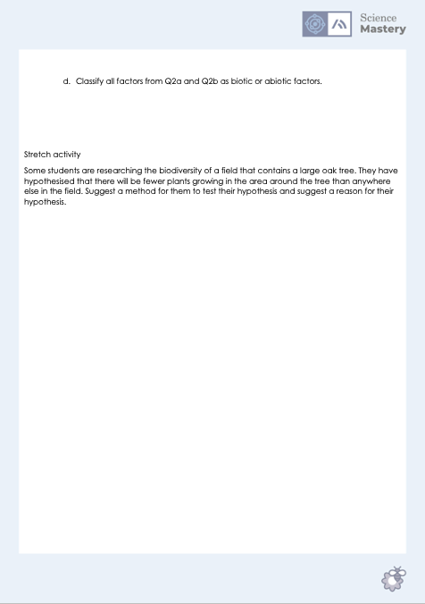
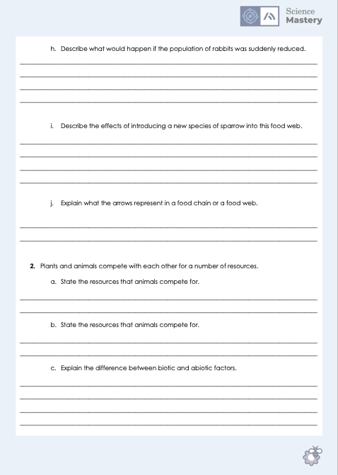
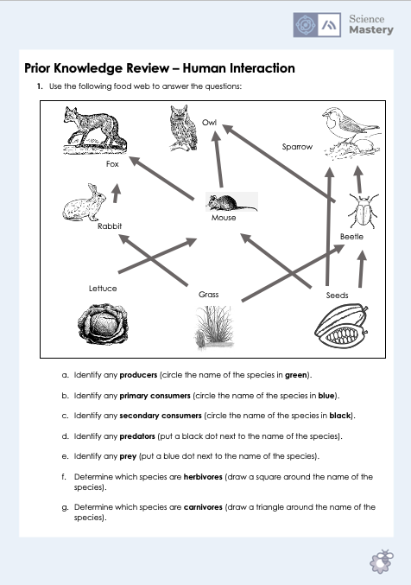
Interdependence Review
Complete the worksheet
Answering in full sentences where necessary
Use different colours to annotate the food web
Notes:
Purpose: students review prior learning from B1.3. Mark scheme provided in separate document for pupils to self or peer assess work.
Annotation instructions can be changed depending on the equipment that pupils have.
Alternative activity – print the definition cards (in separate document) and pupils play articulate, where they read out the definition and other members of their group have to suggest the keyword they are describing. You can scaffold this by giving specific group members more or less difficult definitions to explain. You may also want to add in more keywords or get pupils to write their own on scrap paper if you want to make the more engaging part longer. This can also be used as a matching activity.
Note: if printed double sided, the correct definition should be on the back of the keyword.
Stretch - (the practical will be covered in the next lesson on biodiversity):
Some students are researching the biodiversity of a field that contains a large oak tree. They have hypothesised that there will be fewer plants growing in the area around the tree than anywhere else in the field. Suggest a method for them to test their hypothesis and suggest a reason for their hypothesis.

Slide 11
Answer the questions below.
Which best explains what the arrows on a food chain or food web represent?
A. Which animals are being eaten
B. The direction of energy transfer
C. Producers, primary consumers and secondary consumers
2. A primary consumer is…
A. A carnivore that only eats plants
B. A herbivore that eats other animals
C. A herbivore that eats plants or algae
3. What is the correct definition of a habitat?
A. The interaction between a community and the non-living parts of their environment
B. The place where an organism lives
C. Forest, ocean or desert
✓
✓
✓
Notes:
Q1. Answer: B
If students answer A or C, they need practice on food webs. To fix it, it may be useful to practice further questions like Q1 on the worksheet for this lesson where they need to identify the scientific terminology for different populations.
Q2. Answer: C
If students answer A or B, they may not understand key words from a food web. To fix it you could use a food web and ask pupils to identify a herbivore/carnivore/omnivore or primary/secondary consumer and explain how they know from the food web.
Q3. Answer: B
If students answer A or C, they have most likely confused ecosystem and habitat or given the specific habitats rather than the definition. To fix it you might come up with examples of animals/plants that pupils know and ask them to identify the habitat. e.g polar bear: sea ice (Arctic).

Slide 12
Lesson B3.2.1
What was good about this lesson? | What can we do to improve this lesson?
Send us your feedback by clicking this link. Thank you!

